Slide 1
Accelerator Framework Learning Sessions [ADF ETL Databricks Delta Lake]
10.28.2021

Slide 2
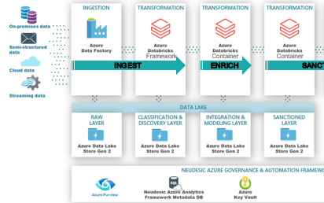
Schedule
Week 1: ADF ETL Process and adl deployments
Week 2: Data-bricks Permissions and secret scopes
Week 3: Data-bricks Framework Orchestration
Week 4: Delta Lake and Meta-Data capabilities

Slide 3
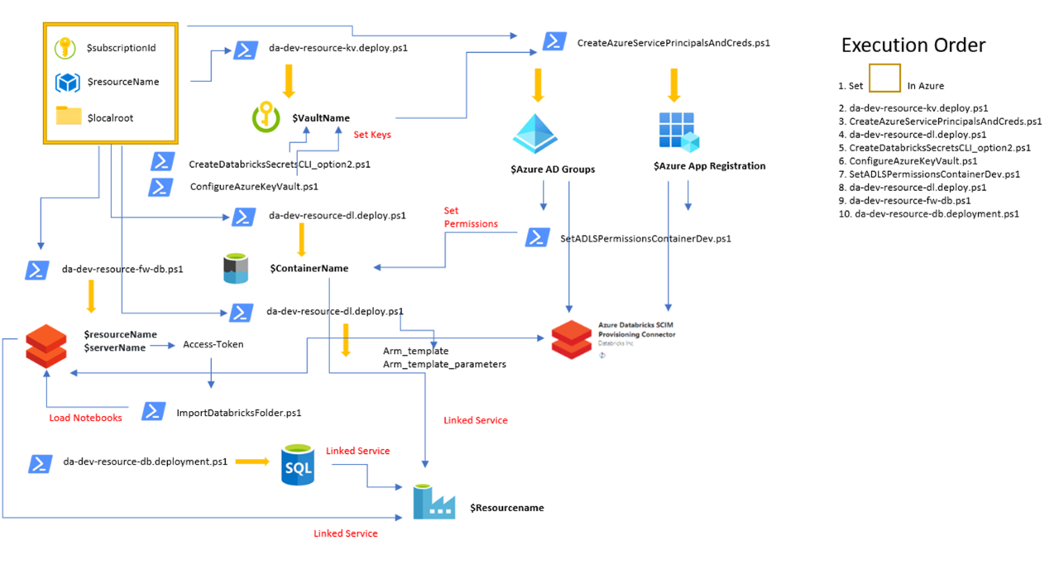
Adl deployment
Additional Config Notes:
Two Databricks workspaces due to framework workspace caching secrets
ACL Access control used for all container access
Local Databricks secret scopes used to databricks container access

Slide 4
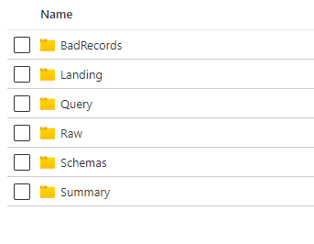
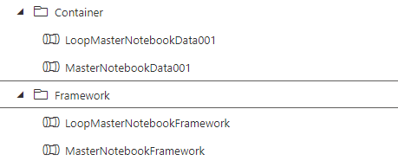

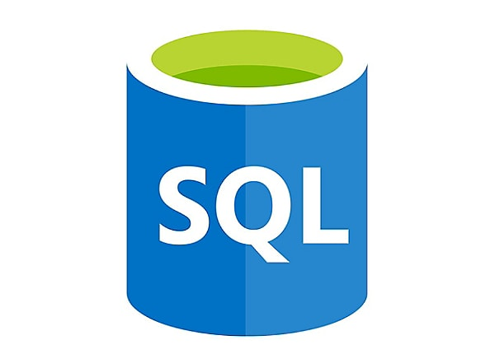
Adl structure
Orchestratration Notes:
Framework Notebook used to ingest data via sql metadata
Container Notebook used to call Databricks notebooks to transform data between staging layers

Slide 5
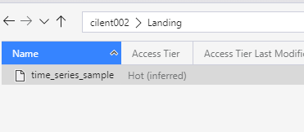


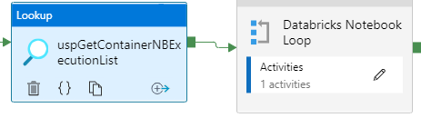
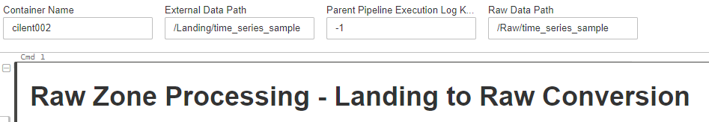

ADF Orchestration Example
Orchestratration Notes:
Pipeline Run Cadence

